Slide 1
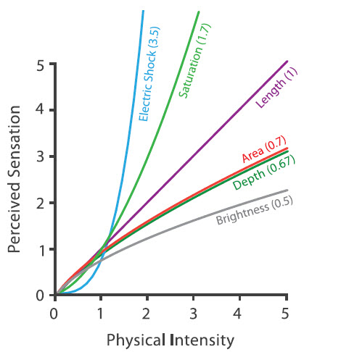
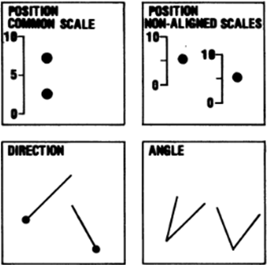
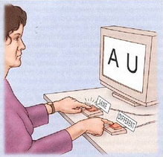
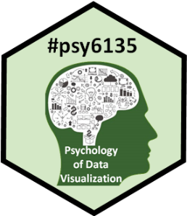
Human Factors Research: How to tell what works
Michael Friendly
Psych 6135
https://friendly.github.io/6135

Slide 2
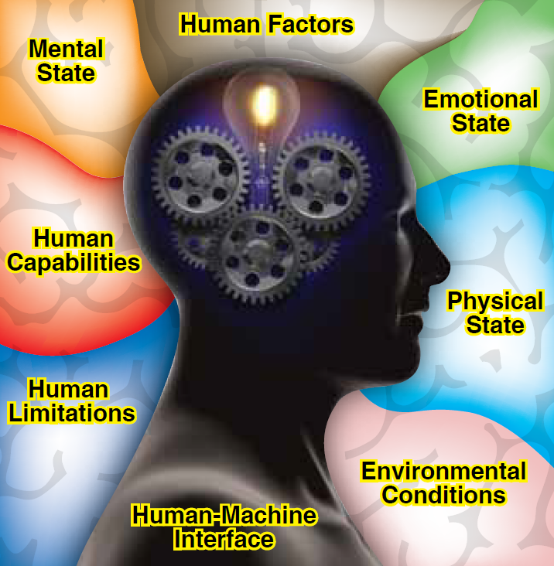
Human Factors
What are the features of:
humans &
task characteristics
that affect task performance?
Image: https://bbpconnect.com.au/event/ozav-seminar-on-human-factors/2020-12-16/

Slide 3
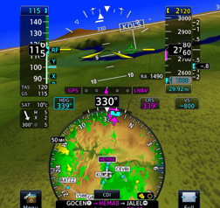
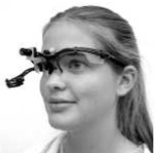
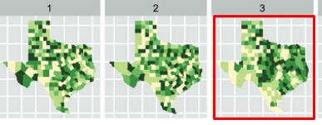
Today’s Topics
Why consider human factors in graphic & information design?
Real-world applications
Data graphs
Empirical study of graphs
Experimental methods
Psychophysical methods
Eye tracking
Computer, web-based experiments
Visual inference

Slide 4
Psychological issues in human factors
The following examples can be analyzed in terms of:
Sensory (iconic) memory
pre-attentive, automatic, feature detection
massively parallel, short duration, easily fooled
Visual attention
limited capacity
drawn to most salient features (color, motion, …)
Top-down processing
Goals, expectations

Slide 5

Control room display
A control room for a nuclear power plant or electrical system for a large city
How does visual design support important decisions?
How to warn or know when something fails?
How many things can the operator attend to at one time?
Find the important target
What visual design factors make important events salient?
Make it BLINK?
Make it spin

Slide 6

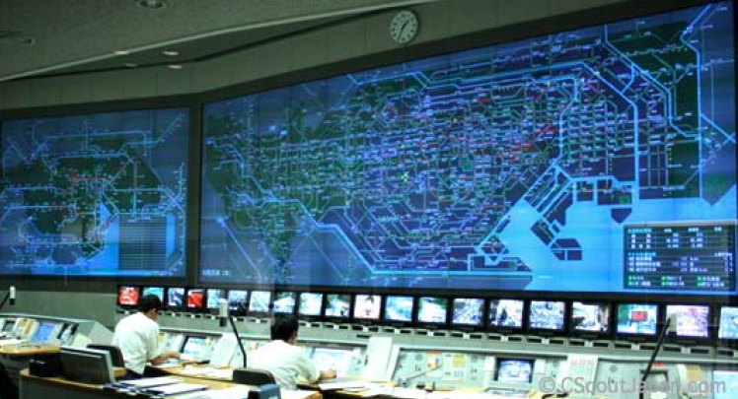
Traffic control display
A traffic control system for a large metropolitan city (Tokyo)
How does visual design support important decisions?
How to warn or know when something fails?
When is there too much information?
oops!

Slide 7
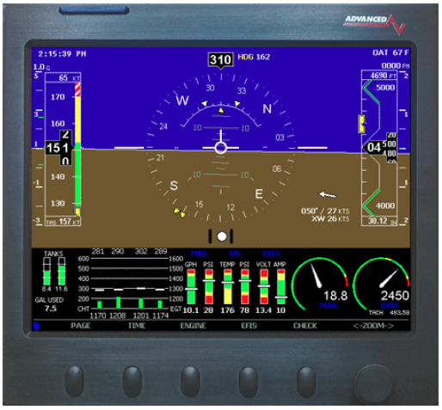
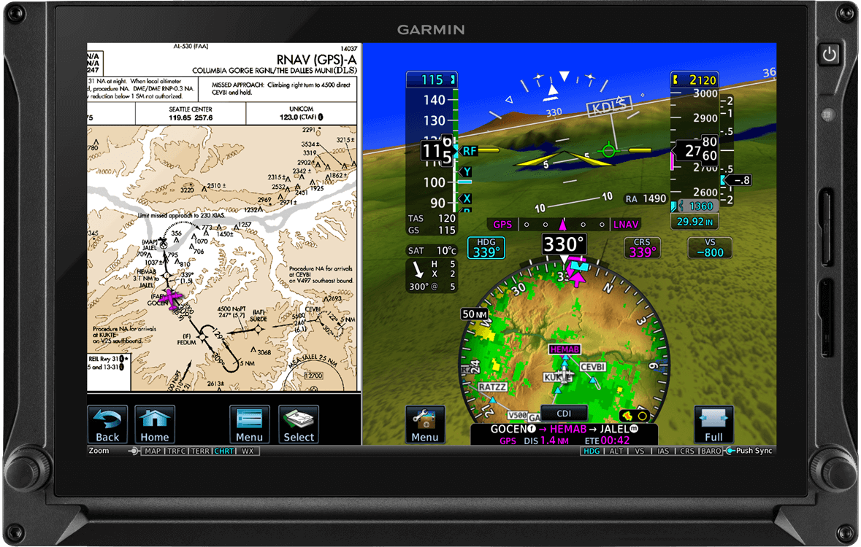
Navigation
An early digital navigation display panel, incorporating visual gauges and charts for a variety of functions– combines separate variables into a single display
What visual features make it easier or harder to navigate?
Garmin Txi touchscreen device for a small jet
How does the pilot combine the map view with the heads-up view and all the visual dials?

Slide 8
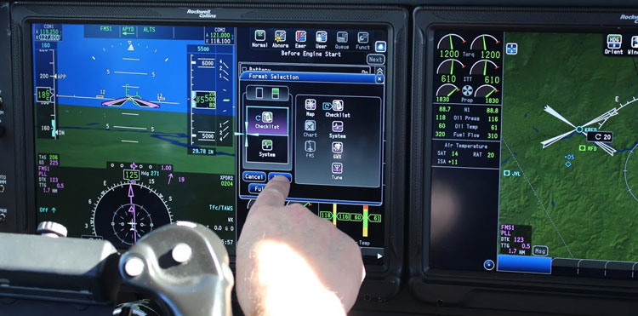
Navigation
A more modern design integrates a wider variety of displays in a touch-screen device
Are there too many options or features?
What features demand the most pilot attention or distract attention from flying?
How to study the efficacy of alternative visual display designs?
Rockwell-Collins Air King control panel

Slide 9
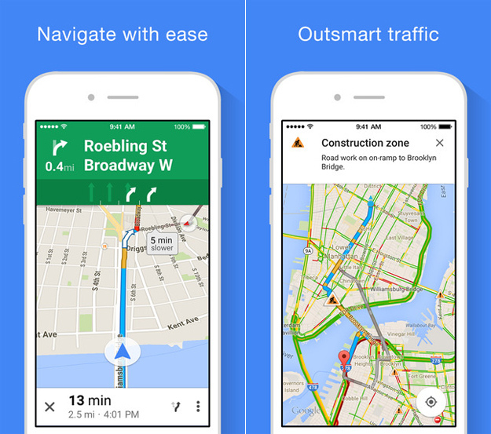
Driving Apps
3D-like display: focus attention on where you are
Next turn indicator
Lane assist
Show alternative routes
Dynamic traffic notices

Slide 10
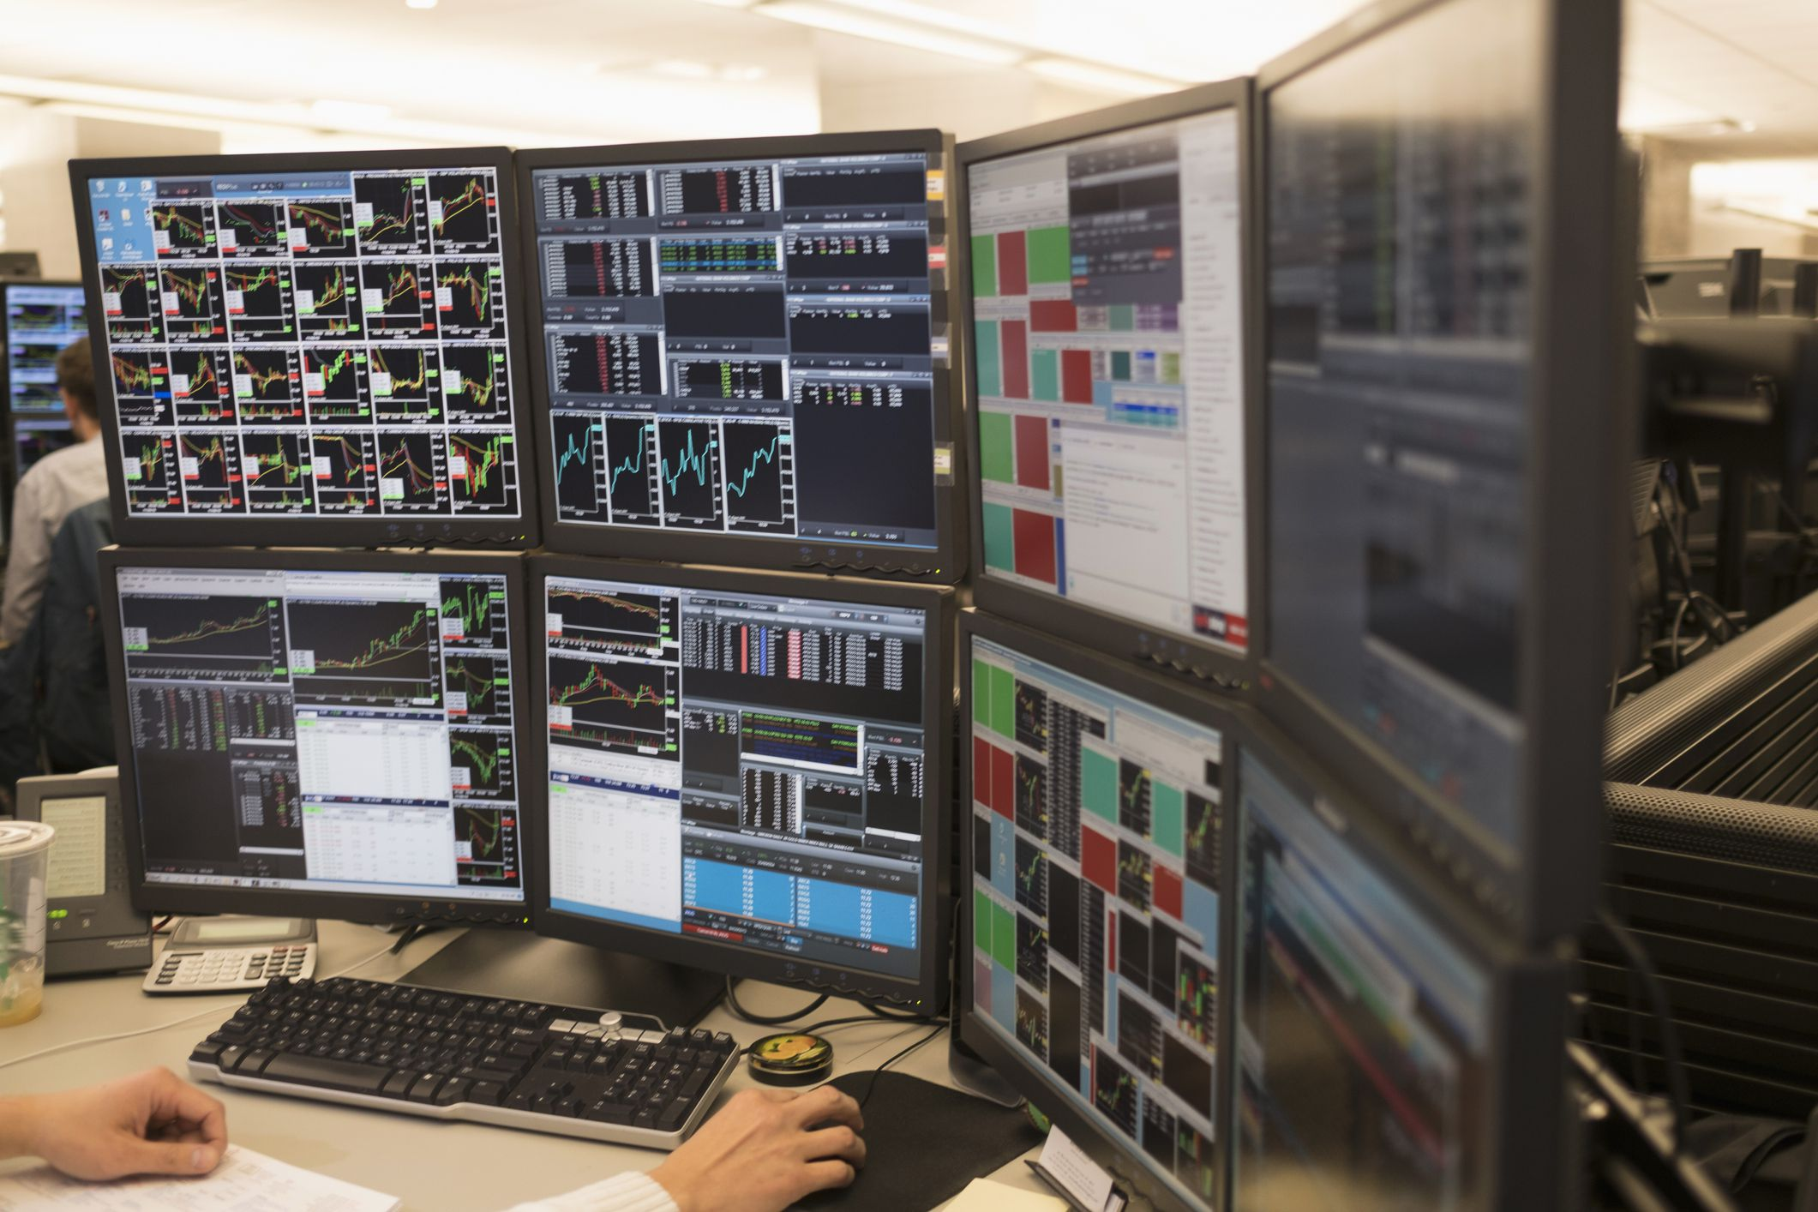
Financial trading desk
BUY!
https://www.varchev.com/en/two-of-the-major-fx-drivers-have-been-removed-whats-next/

Slide 11
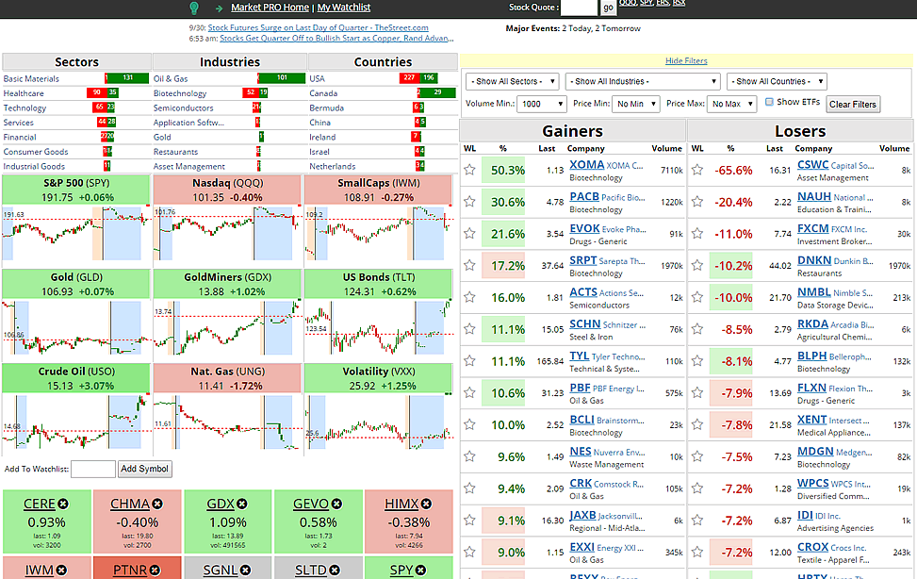
Dashboards: Financial trading
Dashboards combine visual information for decisions on a single screen
Good dashboards are: dynamic, interactive, customizable

Slide 12
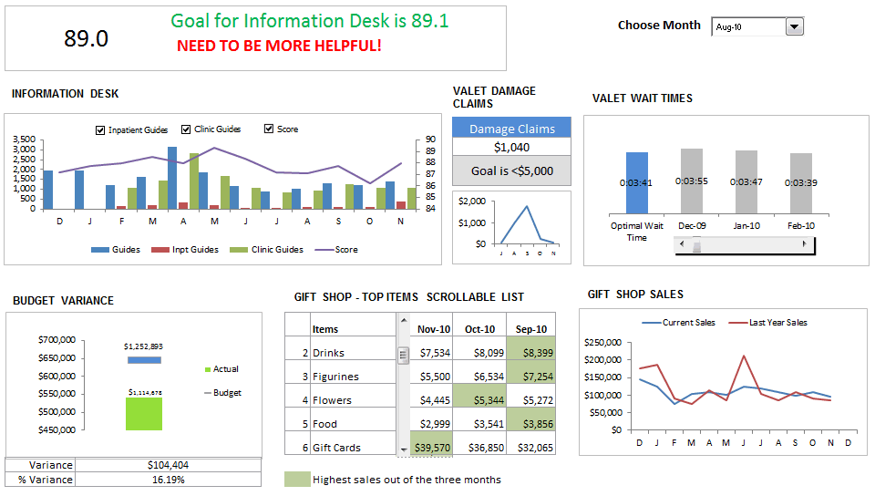
Dashboards: Customer service
Interactive dashboards use sliders, buttons, pick lists, etc.
From: https://chandoo.org/wp/customer-service-dashboard/

Slide 13
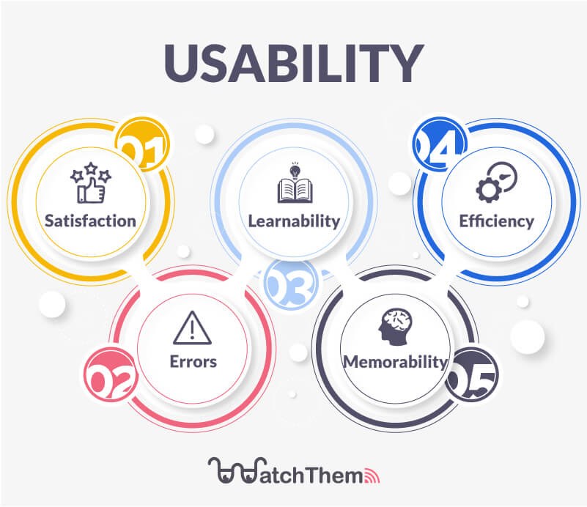
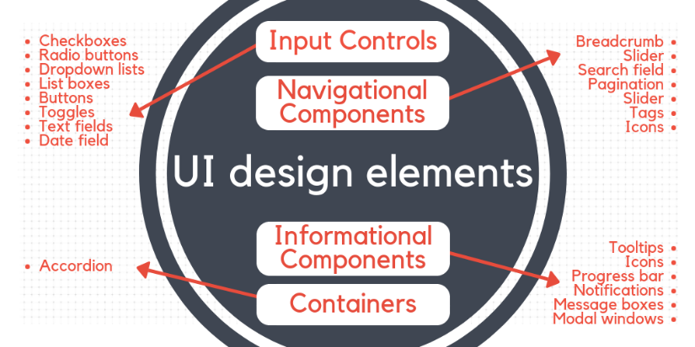
Elements of UI Design
Input controls
Buttons, touch screen?
Screen navigation
Layout
White space
Visual hierarchy
Content
Text, images
Usability
Learnability
Efficiency
Memorability
Avoiding errors
User satisfaction
https://merehead.com/blog/ui-design-trends-in-2020/
https://watchthem.live/ux-design-principles/

Slide 14
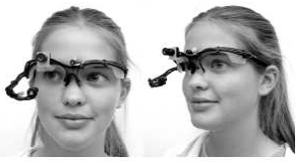
Empirical studies of graphs How can we tell what works?
Human factors vs. Psychology
Experimental methods
Psychophysical methods
Eye-tracking
Task analysis
Running graph perception studies
Some results

Slide 15
Human factors vs. Psychology
Human factors research often motivated by applied problems in engineering, design, computer science
A/B testing (booking.com, Netflix, …) for features of user interaction
navigation controls: pilot testing, flight simulators
Psychological research often motivated by more basic perceptual & cognitive questions.
accuracy, RT of judgments of graphs
visual search, pattern detection
judgments of trend, correlation, etc.

Slide 16
Psychophysical methods
Psychophysical methods are used in studies of graphical perception to study the relationship between
properties of a stimulus (position, length, area, angle, …)
and a perceived response (how big? which is greater?)
Magnitude estimation: rated (0-100) size or %
Matching – adjust size of B so it is same as A
Discrimination
same/different?
which is larger?
Image: http://www.cns.nyu.edu/~david/courses/perception/lecturenotes/psychophysics/psychophysics.html

Slide 17
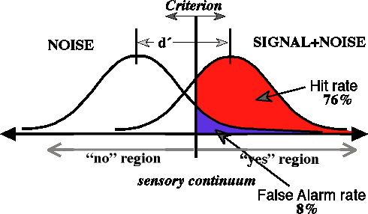
Psychophysical methods: tasks
Methods of adjustment
Adjust intensity of a feature until it is just barely detectable
Adjust one stimulus until just noticeably different (JND) than a standard (difference threshold)
Forced choice tasks
Yes/No: On each trial a “signal” is presented or not
E.g., light, tone, visual feature, outlier, …
“Yes” trials vary in some measure of “intensity”
Results: # hits, # misses -> d’

Slide 18
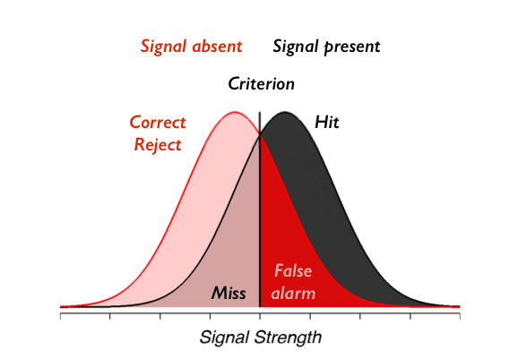
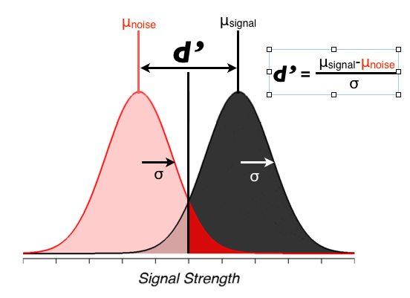
Signal detection theory
Signal detection theory provides a means to assess performance in forced-choice tasks
It imagines that
Stimulus on a given trial evokes a (normal) distribution, N(μ, σ) of internal response
Subject says “Yes” if that is > criterion; else “No”
Trials classified as p(Hit) = Pr(“Yes”| signal), p(FA) = Pr(“Yes” | no signal), …
Sensitivity = d’ = z(Hit) – z(FA)
But: These depend on observer’s criterion (“bias”)
From: Croskerry, P., Campbell, S.G. & Petrie, D.A. The challenge of cognitive science for medical diagnosis. Cogn. Research 8, 13 (2023). https://doi.org/10.1186/s41235-022-00460-z

Slide 19
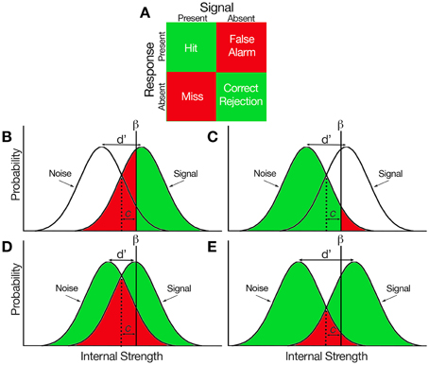
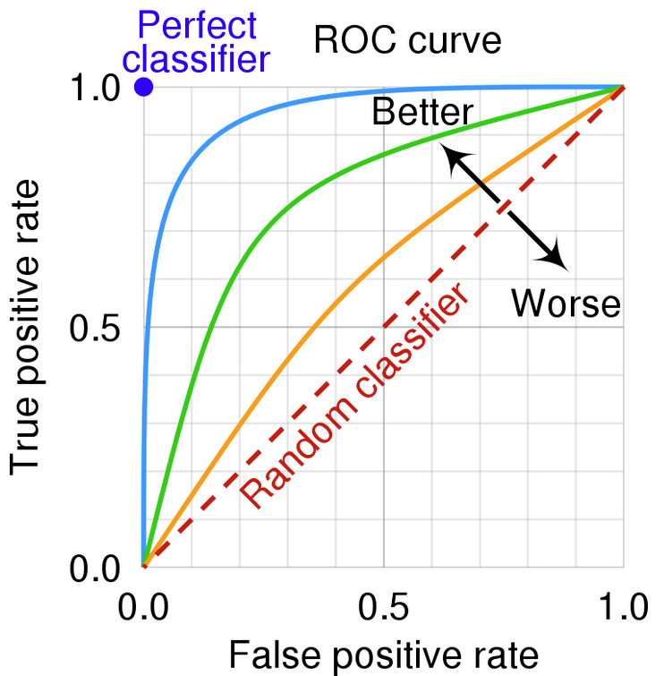
Signal detection theory: measures
d’ (sensitivity) = z(H) – z(FA)
β (bias, criterion) = ratio of normals at the value of d’
c = std distance of criterion from equality
d’ = ∞
d’ = 5
ROC curves: How H & FA vary with constant d’
Area under the curve (AUC = A’) often used as a measure
0.5 ≤ A’ ≤ 1
d’ = 3
d’ = 0
https://neuropsychology.github.io/psycho.R/2018/03/29/SDT.html

Slide 20
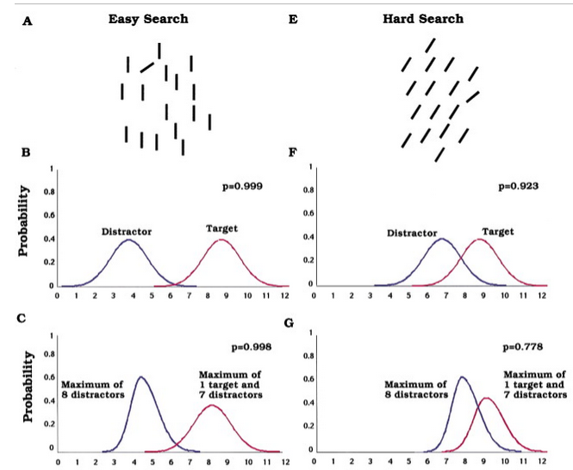
SDT: Visual search task
Signal detection theory analysis of a visual search task
Correct detection
with diff^{ce} of target
↓ with # of distractors
Verghese, P. (2001). Visual Search and Attention: A Signal Detection Theory Approach, Neuron, 31 (4), 523-535, https://doi.org/10.1016/S0896-6273(01)00392-0 .

Slide 21
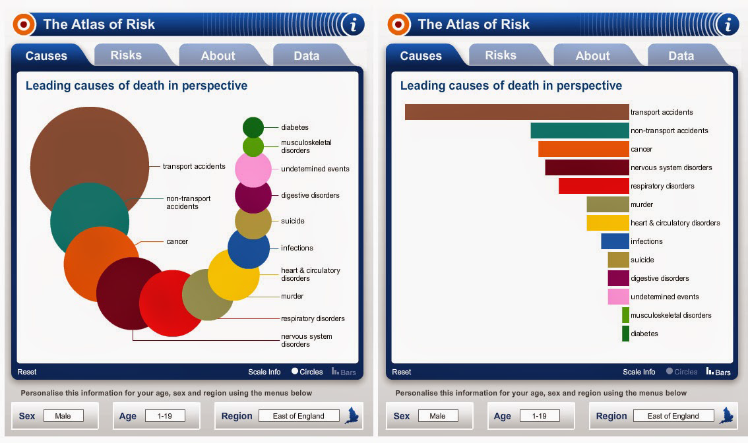
Magnitude estimation
How large are transport accidents?
How much bigger than non-transport accidents?
Estimation of length or ratios of length are more accurate than the same judgments of area.

Slide 22
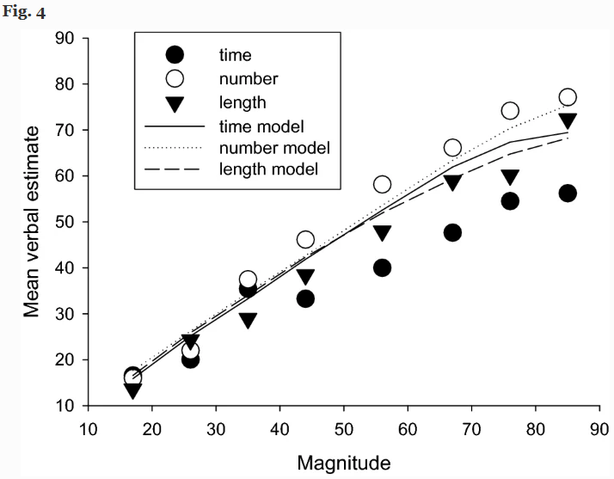
Magnitude estimation: time, number, length
Ogden et al (2020): Verbal estimates of the time (duration), number, or physical length of items presented in visual displays
Verbal judgments of number (numerosity) are more nearly linear over the range
Longer times are underestimated
Ogden, Simmons, & Wearden. Verbal estimation of the magnitude of time, number, and length. Psychological Research 85, 3048–3060 (2021). https://doi.org/10.1007/s00426-020-01456-4

Slide 23
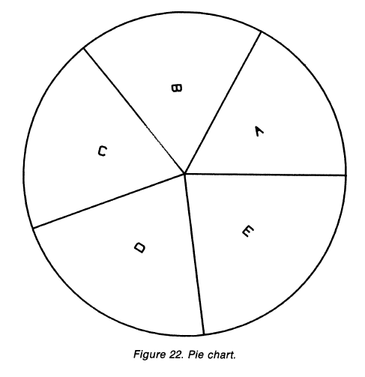
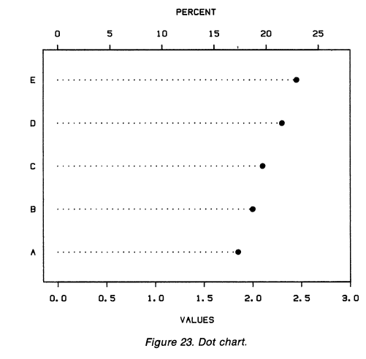
Discrimination: Pies vs. dot charts
Which sector is the largest?
Which is the smallest?
Judgement of position along a scale is more accurate than that of area or angle

Slide 24
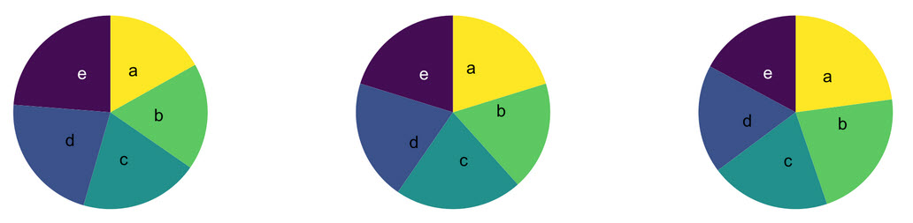
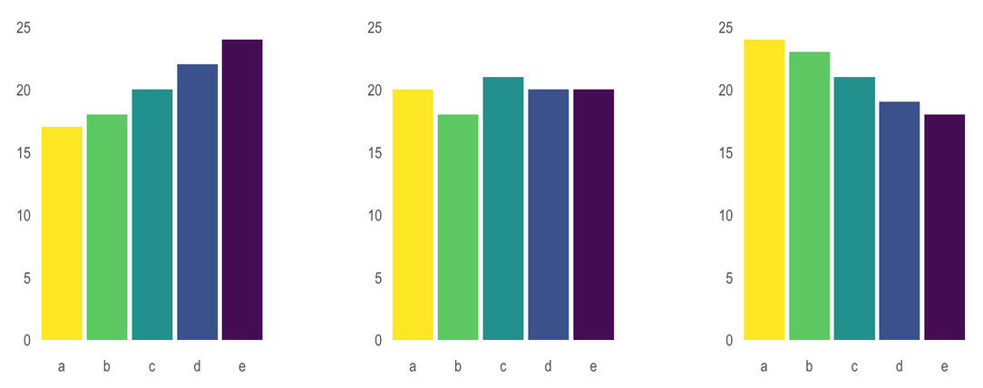
Discrimination: Pies vs. bar charts
In each pie chart: Which sector is the largest? Which is the smallest?
Length more accurate than angle
Which bar is the largest? Which is the smallest?

Slide 25
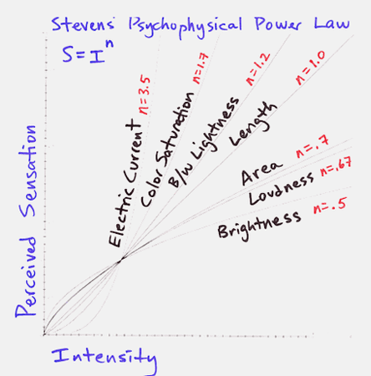
Stevens’ Power Law
How does perceived magnitude of a sensation relate to stimulus intensity?
S. S. Stevens (1957) showed that, for many domains
These provide ways to assess the accuracy of magnitude estimation for visual encodings
length judgments most accurate
area: less so
But: graph perception is not always a matter of estimating magnitudes.
From: https://santhoshsoundar.blog/power-law/

Slide 26
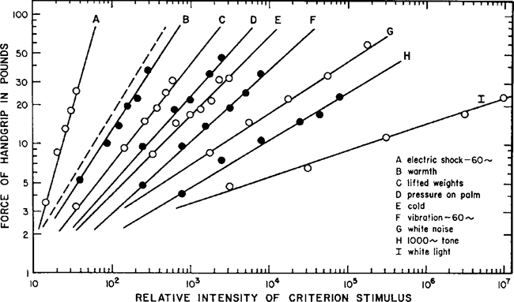

Stevens’ Power Law: log-log form
The exponential form, S ~ Intensity^{p} is more easily understood when both are plotted on log scales, where it is linear
$$log \left(S\right)=p log (I)$$
p is the multiplier effect of a multiple of Intensity

Slide 27
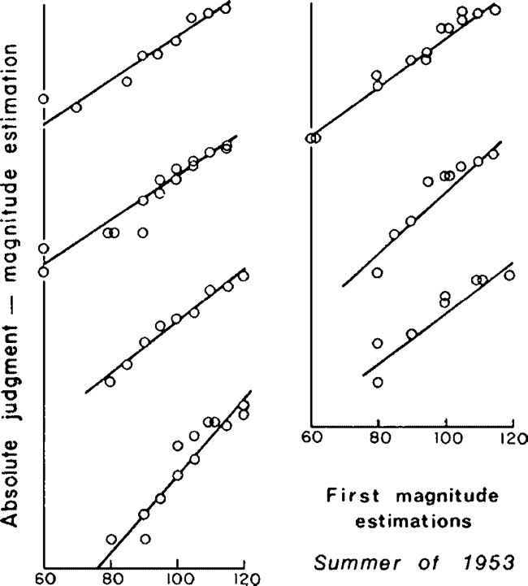
Power Law: Origin story
In 1953, S. S. Stevens carried out experiments on magnitude estimation of loudness of sounds – measured in db (a log scale)
This graph shows results for 7 individual subjects, offset to show the separate data
The idea of an average slope, p, arose later, as the effect for an average observer.
Variability across Ss often not considered.
See: (2009) Stevens’ Power Law. In: Sensory Neuroscience: Four Laws of Psychophysics. Springer, Boston, MA. https://doi.org/10.1007/978-0-387-84849-5_1

Slide 28
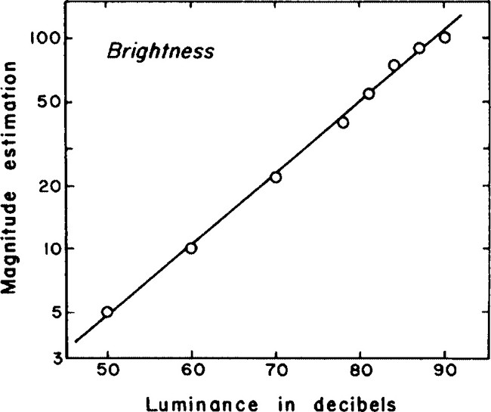
Power Law: Brightness
What about other stimulus domains?
Luminance of a light source could be measured (on a log scale)
Averaging over observers,
log of the magnitude estimates was again linear with log intensity.
slope = 0.5
Stevens (1975) asserted that he had discovered a fundamental law of the relation between physical properties and perception.

Slide 29
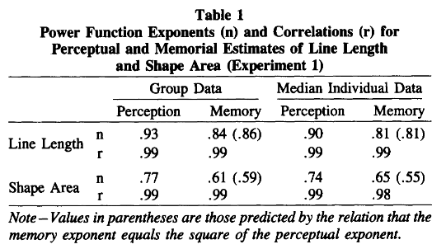
Magnitude estimation & memory
How does remembered size relate to perceived size?
How does it relate to stimulus intensity?
Kerst & Howard (1984) propose another power law:
therefore
If p ≈ p’, the exponent for memory ≈ p²
→ remembered area less accurate than area itself
Kerst & Howard, Bulletin of the Psychonomic Society 1984, 22 (6), 517-520

Slide 30
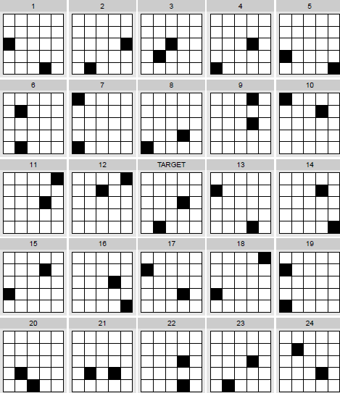
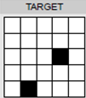
Visual search tasks
Find a target item among the many distractors in this display
Measure:
reaction time (RT)
accuracy (% correct)
Vary:
# distractors
# of targets
complexity (# black squares)
display format
…
This paradigm is often used in evaluating complex visual displays

Slide 31
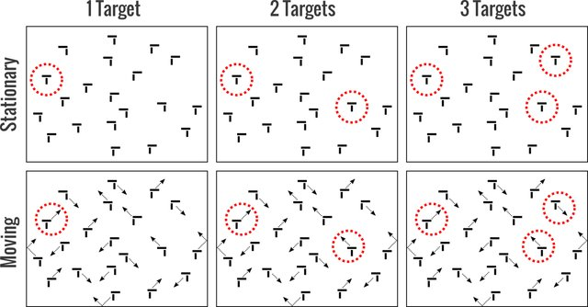
Visual search experiment
Visual search for a diagnostic signal (radiology) can vary with the # of targets and whether these are shown stationary or moving.
Find:
The response measure here is % accuracy in detecting a given target.

Slide 32
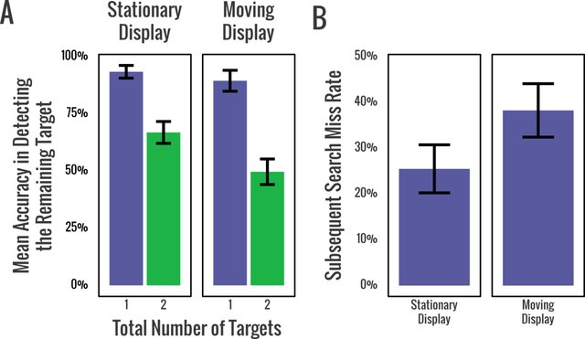
Visual search experiment
Results:
Better for 1 target vs. 2, whether moving or not
A 2nd search is less accurate when the target is moving
From: Stothart et al (2018). Satisfaction in motion: Subsequent search misses are more likely in moving search displays. Psychonomic Bulletin & Review 25(1):409-415

Slide 33





Running graph perception experiments
Paper & pencil tasks
little control of experimental presentation features
can’t measure RT
Lab software: run on lab computers
e-prime ($$$), https://pstnet.com/
matlab ($) & Psychtoolbox: http://psychtoolbox.org/
PsychoPy – free, open source, see: http://www.psychopy.org/
Web-based
Survey Monkey / Qualtrics
Amazon Mechanical Turk

Slide 34
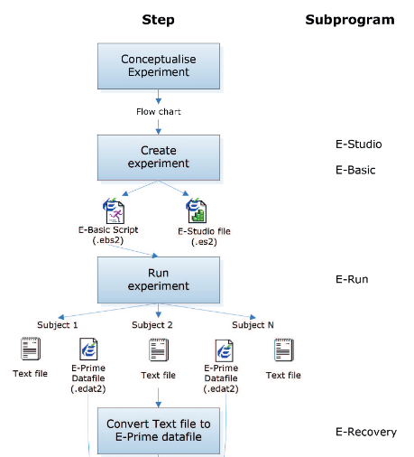
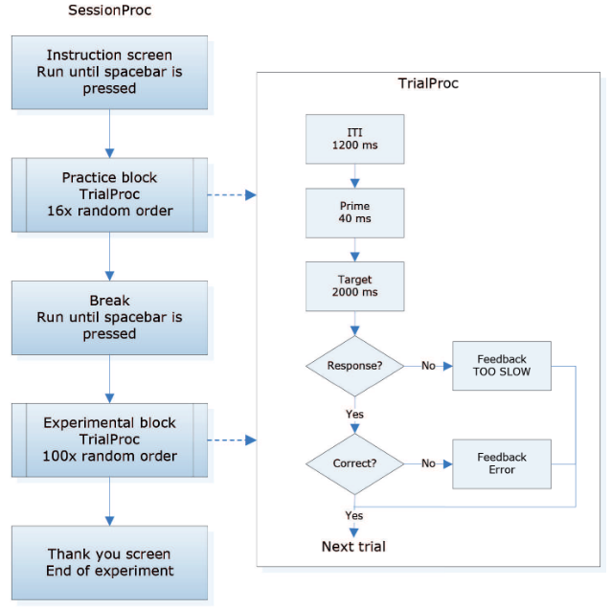
e-prime
e prime is a polished software system for designing psychology experiments
E-Studio GUI → E-Basic script; E-Run: runs experiments

Slide 35
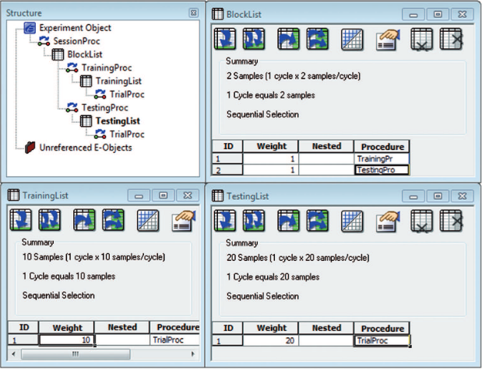
e-prime
Create experiment structure by drag-and-drop in E-Studio
Stimuli: text, audio, images, video, …
Response devices: keyboard, mouse, external devices, …
Experiment structure
Block of trials

Slide 36
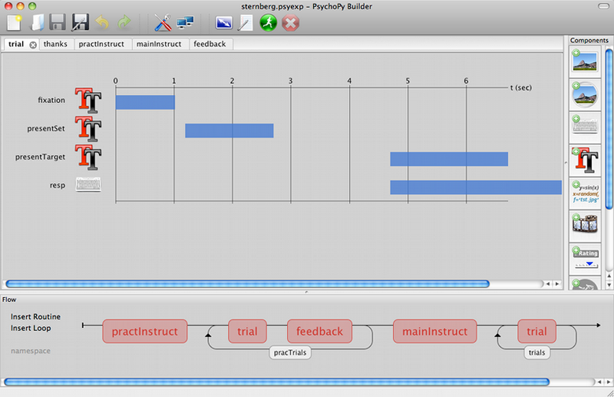
PsychoPy
PsychoPy provides a GUI for constructing online experiments
Builder interface → python code that runs the experiment
https://www.psychopy.org/

Slide 37

Amazon Mechanical Turk
Web-based experiments, hosted on Amazon servers
requester jobs: Human Intelligence Tasks (HITs)
worker pool: Turkers, get paid for doing tasks ($0.01 – 0.10 per item)
each cell of a design can be a separate HIT
Amazon provides a markup language for presenting text, movies, images, … (HTML, javascript)

Slide 38
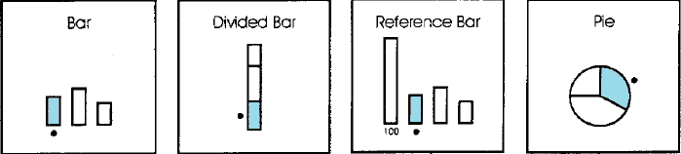
Studies of Graph Perception
Early studies
Elementary perceptual tasks
Accuracy & reaction time
Mental processes in graph perception
Task analysis

Slide 39
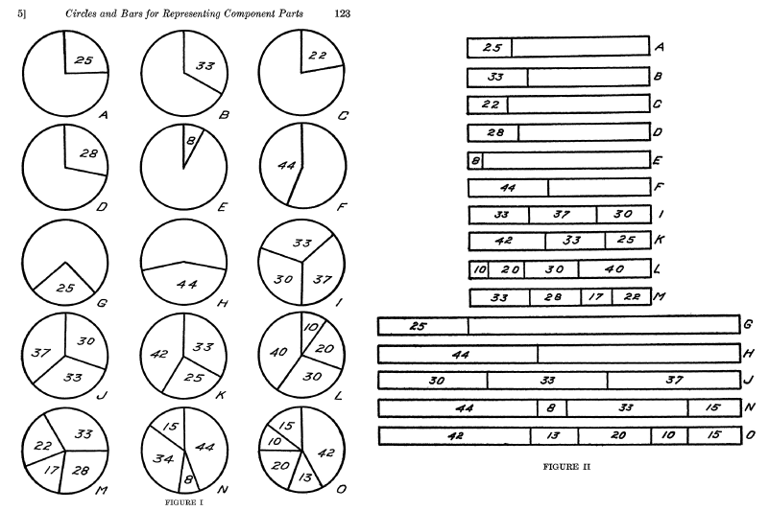
Early studies: Circles vs. bars
Eells (1929) studied magnitude estimation of proportions of a whole, presented as circles vs. bars
“What number represents the proportion for each marked segment?”
Conclusions:
1 segment: circles ≈ bars
>1 segment: circles better than bars
→ Pie charts best, when the task is to judge proportion

Slide 40
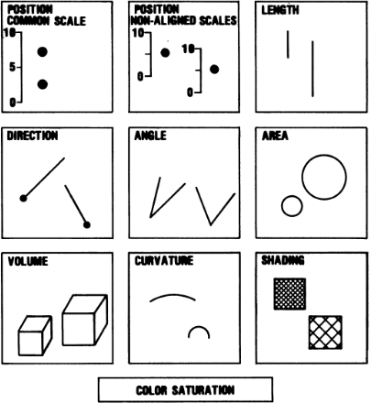
Graph perception: Elementary perceptual tasks
Cleveland & McGill (1984) proposed that graphical perception could be studied in terms of 10 elementary perceptual tasks involved in most common graphs.
Their study was one of the first modern ones.
It set a standard for magnitude estimation tasks of data graphs

Slide 41
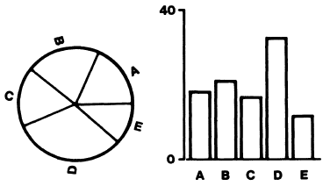
Cleveland & McGill experiments
Pie charts vs. bar charts – position-angle experiment
Elementary perceptual tasks:
bar chart: position along a scale
pie chart: angle? area? arc length?
Experiment:
50 graphs (½ pie, ½ bar), random order
largest marked
“What percent is each of the others?”
“Make a quick visual judgment”
Response on an answer sheet
Measures:
accuracy: log₂(|judged % - true %| +1/8|)
bias: judged % - true %
NB: log scale estimates relative error; +1/8 handles zero values

Slide 42
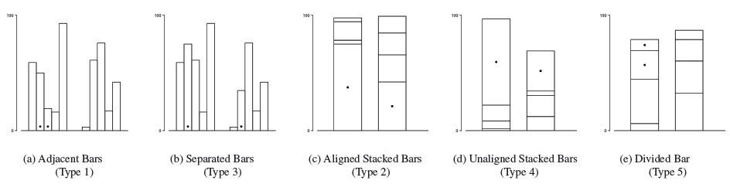
Cleveland & McGill experiments
Bar charts tasks – position-length experiment
Experiment:
50 graphs, 10 × 5 types
“What percent is smaller of the larger ?”
Discussion Q:
What are the elementary perceptual tasks involved in each of these?
What is the statistical analysis?
Measures:
accuracy: log₂(|judged % - true %| +1/8|)
bias: judged % - true %

Slide 43
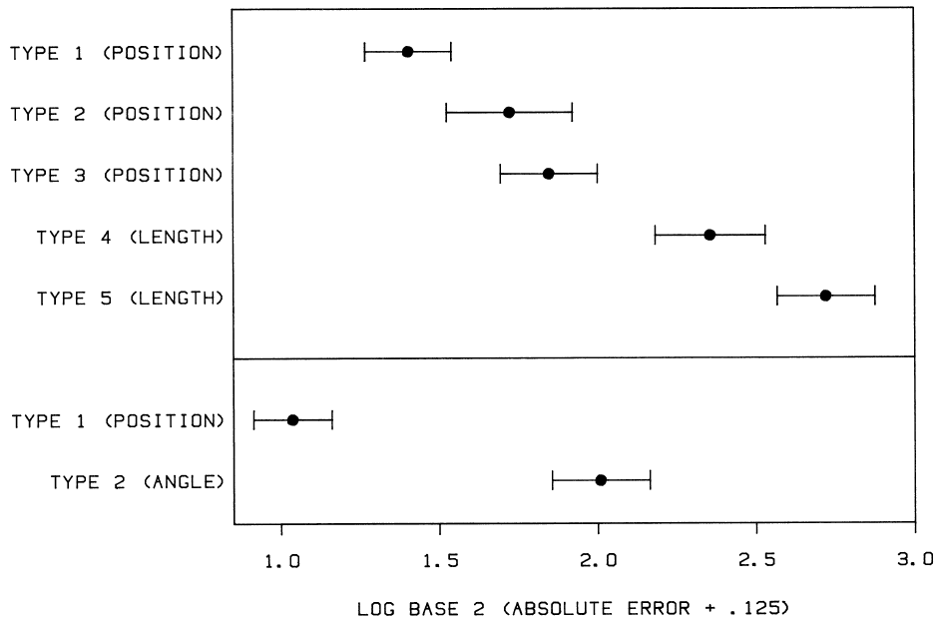


Cleveland & McGill experiments
Cleveland & McGill summarized these experiments in this figure, comparing absolute error in the tasks in these two experiments.
Adjacent bars
Position--length
Separated bars
Aligned stacked
Unaligned stacked
Divided bars
Position--angle
NB: confidence intervals based on bootstrap of log |error| because of (a) non-normality; (b) repeated measures

Slide 44

Heer & Bostock: MTurk experiments
Replicated Cleveland & McGill T1—T5, T6 (angle)
Added area judgment tasks:
T7: Bubble chart
T8: Center-aligned rectangles
T9: Treemap
T9
T7
Task:
“What % is area A of area B?”
B
A
A
B
T8

Slide 45

Heer & Bostock: results
Results largely confirmed Cleveland & McGill (1984) with respect to relative order
The area judgment tasks are shown to give even larger errors
Details:
H & B use a between-S design, n=50 per chart type, 10 charts of each type
10 × 7 = 70 separate HITs (each S responds to 1 chart)
Response: type in a # (% of smaller)
This graph of these results is a great model for data display
Fig. 5.8 from: Munzner, Visualization Analysis & Design

Slide 46

Heer & Bostock: results
Other findings:
For a given graph type, judgments are most accurate when the true difference is extreme
Also: Asymmetric, peak at ~55%
The within-graph effect is larger than the differences between graphs
Discussion Q:
What are some problems with this graph?
How could it be improved?
Reduce prominence of grid lines
Direct labels
Different point shapes

Slide 47

Effect of truncation in bar charts
An Mturk experiment to assess the effect of Y-axis truncation on relative judgements
How do bookings to {A} compare to bookings to {B}?
1
4
7
not at all different
moderately different
extremely different
{A}
{B}
{A}
{B}
Not truncated
Truncated
Yang et al., Truncating Bar Graphs Persistently Misleads Viewers, Journal of Applied Research in Memory and Cognition, 2021, https://doi.org/10.1016/j.jarmac.2020.10.002

Slide 48

Effect of truncation in bar charts
Design: Within-S, each subject saw 20 control bar graphs and 20 truncated bar graphs
Study 2: Subjects warned that some graphs might be misleading (n=109)
Study 1: No warning (n=24)
This graph form (“raincloud plot”) combines density estimates, data dots & CIs
Study 2 tests an interpretation based on task mental set / instructions

Slide 49

Simkin & Hastie: accuracy and RT
Problems with Cleveland & McGill study:
Assessing accuracy-only omits consideration of speed of judgment – should also measure reaction time
“Elementary perceptual tasks” give no insight into the cognitive processes used by observers to perform these judgments.
Simkin & Hastie used computer-controlled experiments to measure both accuracy & RT
Three types of stimuli x 30 of each = 90 trials
Discrimination task: Which is larger?
Judgment task: What % is smaller of the larger?
Analyses: Separate ANOVAs of discrimination RT, judgment RT and errors in each task
Simkin & Hastie (1987), An Information-Processing Analysis of Graph Perception, JASA, 82, 454-465

Slide 50

Simkin & Hastie: processing stages
They propose that tasks using various graph types can be understood in terms of elementary mental processes:
anchoring: segment a component to serve as a standard for comparison
scanning: visual sweep across a distance in a graph
projection: send a ray from one point to another
superimposition: mentally move elements to a new, overlapping location
detection: detect difference in size of two components

Slide 51

Simkin & Hastie: processing stages
Analysis of the three graph types in terms of proposed elementary mental processes
bar chart (position)
divided bar (length)
pie chart (angle)
NB: If these processes are sequential, RTs should reflect additive components
AFAIK, this idea has not been tested or explored.

Slide 52

Hollands & Spence: Discrimination analysis
How do people make decisions about which is larger from different visualizations?
aligned vs. not aligned
pie vs. bar chart
Hollands & Spence propose an incremental estimation model to account for speed of processing:
each stimulus evokes a distribution of a psychological response of “size”
the response (A>B?) is determined by the separation and overlap between the two distributions
less overlap → faster response
Hollands, J. & Spence, I. (2001). The discrimination of graphical elements. Applied Cognitive Psychology, 15, 413-431.

Slide 53

Hollands & Spence: results
Experiment 1
RT ↓ as Δp ↑
RT < for aligned vs. non-aligned
RT < for divided bars vs. pies
Similar pattern for errors
RT
Errors

Slide 54

Are pies ever better?
What percent is the indicated region of the total?
Other experiments by Holland & Spence (1992, 1998) show that this judgment task is hardest for separated bars and easiest for pie charts
Hollands, J. & Spence, I. (1998). Judging Proportion with Graphs: The Summation Model. Applied Cognitive Psychology, 12, 173-190

Slide 55


More pie studies: Skau & Kosera
Infographics use many variations of the basic pie chart to show part-whole relations
What properties do people use in making judgments: Angle, area, arc length?
Variations of these designed to test accuracy of part-whole judgments
Skau & Kosara (2016), Arcs, Angles, or Areas: Individual Data Encodings in Pie and Donut Charts, EuroVis.

Slide 56


More pie studies: Skau & Kosera
Little difference among these, except for plots showing only angle

Slide 57

Task analysis
Another cognitive approach is to study the visual/mental steps a viewer takes in trying to answer a question based on a graph. Sometimes uses “protocol analysis”
Q: What is the relationship between the length of the eruption and the time between eruptions for Old Faithful?
Mental steps:
Understand the Q: identify "length of eruption“ & "time between eruptions" as things to search for in the graph.
Look at axis labels: See Y: “Eruption length”; X: “Time between Eruptions
Scan data: See “Y increases as X increases”
Answer the Q: As the time between eruptions increases, the length of the eruption seems to increase.
Notice: Hmm, something weird here!
Illustration from VanderPlas (2015), Perception in statistical graphics, PhD thesis, Iowa State U

Slide 58

Eye-tracking studies
Where do people look when viewing graphic displays?
Eye-tracking hardware allows recording of gaze fixation points over time
Eye-tracking software allows some visual analysis

Slide 59


Viewing a bar chart
This 2016 study by Trent Fawcett was a basic test of this methodology.
Uses R and the saccades package. There is also: gazepath, emov and more…
Gaze fixation points with a scatterplot and transparency to show density
Gaze fixation points showing the temporal sequence of saccades
Fawcett, T. "The Eyes Have It: Eye Tracking Data Visualizations of Viewing Patterns of Statistical Graphics" (2016). https://digitalcommons.usu.edu/gradreports/787

Slide 60

Viewing web pages
This methodology is now well developed, particularly for viewing web pages
This illustration uses heatmap colors to show density of gaze locations

Slide 61

Viewing web pages
This illustration shows a path of eye-movement locations in viewing the same web page

Slide 62

Viewing web pages
This method is widely used to evaluate effectiveness & $ for ads on web pages
Online vendors do numerous such studies

Slide 63
Accessibility of data visualization
Graph design
Design for color deficiencies
Favor direct labels over legends
Assistive technology
Data sonification: map data to sounds
Screen readers: turn text into speech
Text, titles, captions
Web: use alt-text <img alt=“What to understand here”>
PPT: embed descriptive text in images
Papers: use better titles and captions

Slide 64

Accessibility of graph captions
Lundgard & Satyanarayan (2022) studied how graph captions affect understanding, particularly for disabled (blind) viewers
How to design figure captions / alt-text to better communicate what is to be shown?
Accessible Visualization via Natural Language Descriptions, http://vis.csail.mit.edu/pubs/vis-text-model

Slide 65



Accessibility of graph captions
They present a model of 4 levels of description and their semantic content

Slide 66

Study design
Stimuli:
chart types (bar, line, scatter)
topics (academic, business, journalism)
difficulty (easy, medium, hard)
Subjects: 90 sighted, & 30 blind (proficient with a screen reader).
Task: rank the usefulness of 4 descriptions (Levels 1-4) for understanding
Read the paper to see the scope and content of this type of research

Slide 67
BrailleR package
Improve access to graphs for blind users
Describe(): quick description of a graph
VI(): visual inspection of a graph
MakeAccessibleSVG(): create webpages a user can explore by using arrow keys & basic navigation buttons
basicPlot <- ggplot(iris, aes(Sepal.Length, Sepal.Width)) +
geom_point()
Describe(basicPlot)
Output:
A geom_point layer created with the ggplot2 framework
General Description:
A scatter plot shows the relationship between two variables by plotting a symbol for each observation at the coordinates for the two variables.
There’s a lot more here. Check out: https://rdrr.io/cran/BrailleR/f/vignettes/BrailleR.Rmd

Slide 68

Visual inference
To what extent can visual display of real data, against a background of random data, be used as a substitute for standard statistical inference?
One of these plots doesn’t belong. Which one??
Six choropleth maps of cancer deaths in Texas, darker colors = more deaths.
Can you spot which of the six plots is made from a real dataset vs. simulated under the null hypothesis of spatial independence?
From: Wickham etal. (2010) Graphical Inference for Infovis, IEEE Trans. Visualization & Computer Graphics, Vol. 16, No. 6, 972-979.

Slide 69

Visual inference: Lineup protocol
Buja etal. (2009) propose an analogy between standard statistical inference and visual inference based on human observers
Lineup protocol:
• Generate n−1 decoys (null data sets).
• Make plots of the decoys, and randomly position a plot of the
true data.
• Show to an impartial observer. Can they spot the real data?
With n=19 decoys, a correct decision by chance would have p=1/20 = 0.05
From: Buja etal. (2009), Statistical inference for exploratory data analysis and model diagnostics. Phil. Trans. R. Soc. A, 367, 4361–4383

Slide 70

Visual inference: Lineup protocol
This graphic table makes the comparison more direct:
From: Majumder, Hofmann & Cook (2013) Validation of Visual Statistical Inference, Applied to Linear Models, JASA, 108:503, 942-956, DOI: 10.1080/01621459.2013.808157

Slide 71

Frequency distribution of tips at restaurants.
Which one is the real data?
What features lead you to this conclusion?
Panel 11:
Skewed
Multiple peaks
Outliers

Slide 72

Visual t-test
For each data set, the observations are shown as points and the group means as crosses.
The accused (real data) is hidden amongst eight innocents.
Can you spot him?
Panel 3: a larger difference among the group means

Slide 73

Visual tests for linear models
This idea can be extended to visual inference for a wide range of hypotheses in linear models.
Main idea: Numerical test → Visual test
From: Majumder etal (2013) Validation of Visual Statistical Inference, Applied to Linear Models, JASA

Slide 74

Visual inference: Power
Some statistical tests have greater power to detect a non-null effect
What can be said about the power of different graphical methods for visual inference?
Graphs of wind direction and arrival delays for incoming flights to Phoenix airport.
1: polar scatterplot, delay=radius, wind=angle
2: boxplots of delay grouped by angle
Which is easier?
Which is the real data?

Slide 75

Visual inference: Discussion
What can we learn from this approach?
To what extent can visual inference substitute for numerical statistical inference?
How to study this more?
How many observers to declare some effect “significant”
Can we use this paradigm to study observer differences?
Can we use this to study the effectiveness of different graph types or forms?

Slide 76

Online studies: Demographics
It is relatively easy to conduct online studies of graph perception.
For validity & comprehensibility of results, it is often crucial to examine possible demographic variables that relate to the outcome
What was the effect of various subject variables on outcome in a lineup task?
Various demographic variables are ordered here by the effect size for differences among various groups.
When several visual displays are compared, important to consider interactions – some people may do better with some displays.
from VanderPlas (2015), Perception in statistical graphics, PhD thesis, Iowa State U, Fig. 4.5

Slide 77
Discussion questions
Why is human factor research in graphics useful & important?
How can it make a difference?
What methods are available to study this?
What is the task?
How to measure “performance”?
What have we learned?
How to go forward?

